Slide 1
Digi
Quest
Jennifer Menjivar

Slide 2
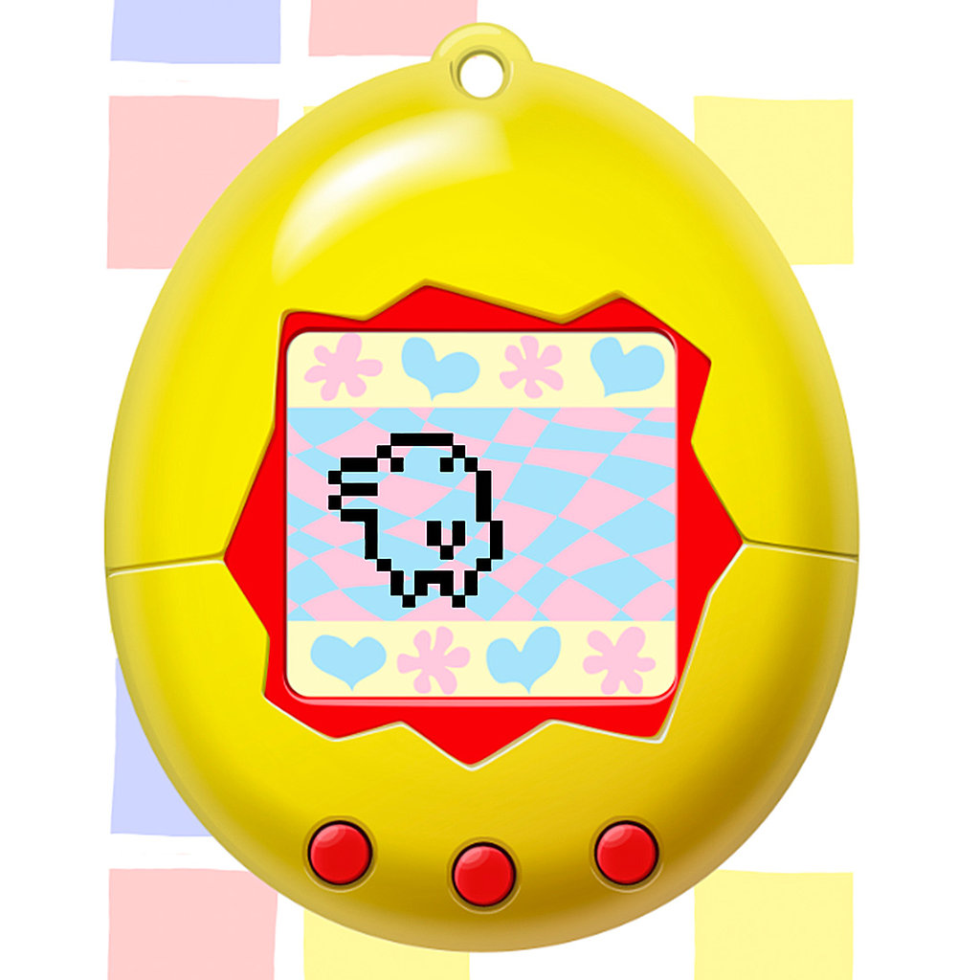
What
Digi quest is a virtual pet that you can take around with you. As you walk with your pet, It will grow from baby to adolescence in which then you can use it to battle monsters along the path that you choose.
It’s going to be a mini PDA looking device that you can take with you wherever you go.
It is going to use a step counter part that counts the steps as time that will help the pet grow.
It will evolve 4 times until it reaches its final stage

Slide 3
Who
Digi quest is mainly for kids 10+
Can be for casual or hardcore gamers

Slide 4
Where
The demographic is going to be in the Urban and suburban. Around the city area
Any place where people and kids like to go out to play

Slide 5
How: Bonding during baby phase
In the beginning, you get an egg which will hatch into a baby pet.
To start playing, every 100 steps you take, the device will notify you that the pet needs to be fed.
When you feed it, it will gain a +1 bondage
The higher the bondage you have, the more it will listen to you and the higher chance you will win prizes and treasure.
If you go on without feeding it, it will not get a +1 bondage
When it reaches its adolescence, the bondage will stop growing as fast it ww
You will have a chance to level up Bondage 4 times
After the 4th time, it will evolve

Slide 6
Bonding
If you don’t feed it during its baby phase, it will run away.
It will also take on different forms depending on the amount of bondage it has.
Also if it is only fed 2 times, it will be losing a lot.
If you lose against a monster it will also lose bondage. If it reaches zero it will run away.
But if you chose to care for it when it lost it will gain +2 bondage so that you may still have a chance.

Slide 7
Adolescence
When the pet is at it’s adolescence stage. It will start to encounter monsters as you walk with it.
about every 200 steps it will encounter either a monster or an item or both.
It will need more experience points to level up its strength and stealthiness
To get points to level up strength and stealth, you can either make the pet fight, run, or sneak

Slide 8
Fighting: Strength
when you fight and win, you will gain +1 strength
The higher your strength is, the higher the chance of winning against a monster
You will be able to fight stronger monsters and gain more points

Slide 9
Fighting: Running
when you run away, depending on how high your stealth is, you might or might not succeed in running away.
If you succeed in running away, you gain nothing, instead you just encounter something else when you start walking again if the last monster seemed too risky
When you run, you run back to the last checkpoint and you try again without gaining or losing anything

Slide 10
Fighting: Stealth
To level stealth, sometimes you may encounter a sleeping monster, and it may be too strong to beat if you decide to fight it. If you sneak around it, you gain +1 Stealth.
This will come in handy when you happen encounter both a monster and an item and you just want to get the item without waking the monster.
This also gives you more of a chance to run away when your pet is being attacked
Sometimes there are more points in the item/treasure than fighting the monster

Slide 11
Status
There won’t be a 100% win rate during the quest
The highest Strength rate or stealth rate would be like 65% of winning
The level of bondage you will have will directly affect how much info is shown on the monster
There will also be a status of the monster you encountered. You can see it’s level of difficulty
The mini boss or final boss’s status will be unknown

Slide 12
Why
The little story behind digi quest is: you find a lost egg in the wilderness, when it hatches, it will want to reach a certain destination where it will find its parents or a new home, etc.
In the beginning, you have to try to gain as much trust as you can so that it will listen to you (bondage) when you guide it along treacherous paths.
As it grows it will become stronger and smarter so that when it reaches it’s destination, it will be able to take care of itself

Slide 13
Items/treasures
The items that you may come across will give you a point that you get to choose which stat you want to place it on.
You get more points when you go up against stronger monsters or find treasures

Slide 14
Losing
You lose the game when your bondage reaches 0
The game starts all over with a different egg
You will lose 1 point of bondage if the pet loses
If you happen to go against a mini boss or the final boss, you will lose all your bondage and have to start all over
When you're up against a mini boss or final boss and lose, you will have a 50% chance that you can encourage your pet to continue from there and that will raise the bond by +2

Slide 15
Checkpoints
There will be a sort of save point after a certain amount of steps
(For now) every 2000 steps marks a check point
If you lose from 2001-2999 then it will start back from the last checkpoint

Slide 16
Evolving
When it evolves, it gains +1 on everything(strength, stealth, bondage)
It will also change forms
On the LCD screen, It will show a different shaped pet after every evolution
Every 1000 steps you take marks another evolution and a check point

Slide 17
The LCD screen
On the screen, as you walk, it will only show the pet, its stats and the number of steps taken
If you press one of the buttons, it will show you it’s evolution state.
When you encounter a monster, it will show a picture of a monster, or a gif of a monster that will show its level of difficulty. Shown by stars or some type of symbol

Slide 18
Winning
To finish the game, you have to reach the other side of the wilderness.
You have to pass a boss level or a boss battle to reach it
When you get the pet to the other side, it will go on its own and will be a sad moment because you did all the raising and it will just leave without looking back

Slide 19
Pedometer
The step counter will be a counter that will progress the game along
Nothing will happen if you don't walk with it
The pedometer will reset if you reset it or if the bond reaches 0

